Slide 1
Taxi fare EDA
Group 2

Slide 2

Overview
Data distribution
Outliers
Car conditions vs fare amount
Seasonal changes vs fare amount

Slide 3
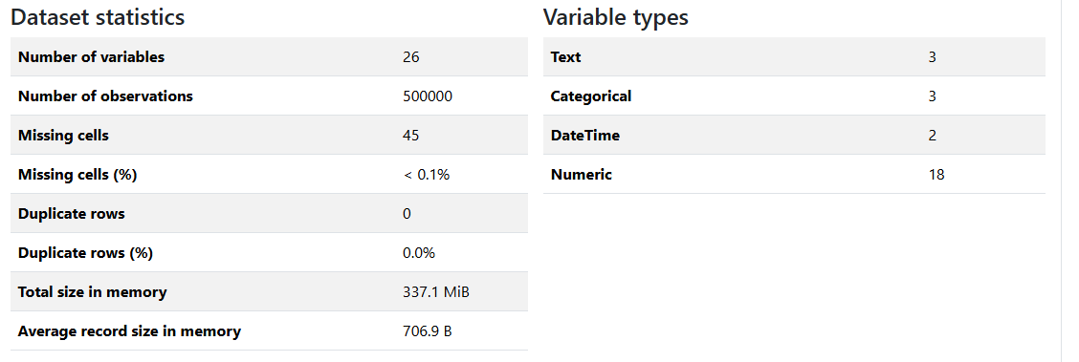
Dataset stats using pandas profiling

Slide 4
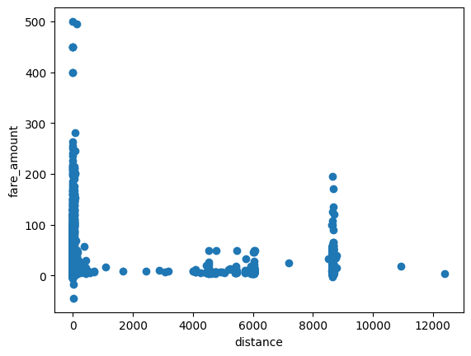
Distances vs fare amount
Rush hour ride may have contributed to various outliers which has caused a high increase in fare amount without a justifiable distance.

Slide 5
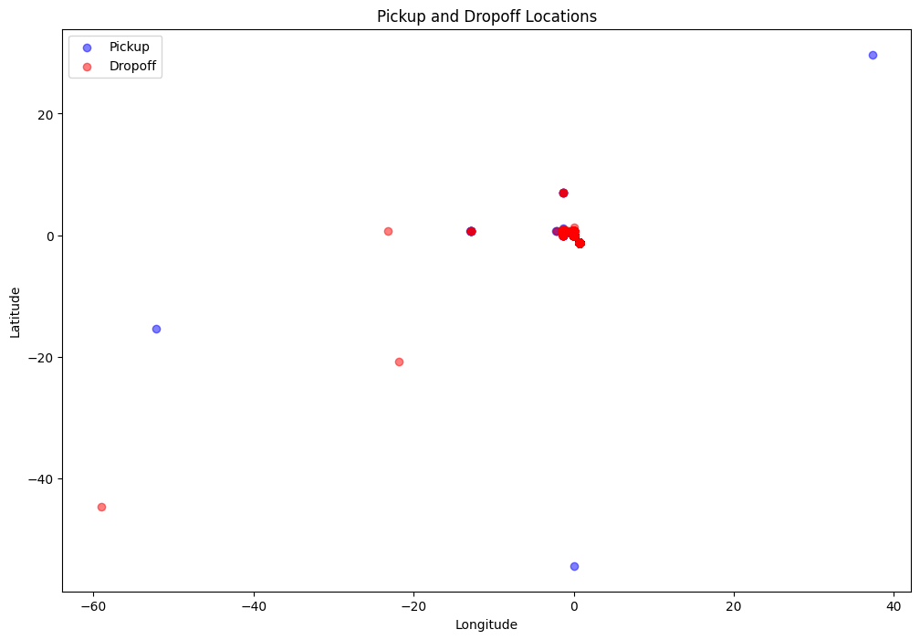
Pickup and drop-off distribution

Slide 6
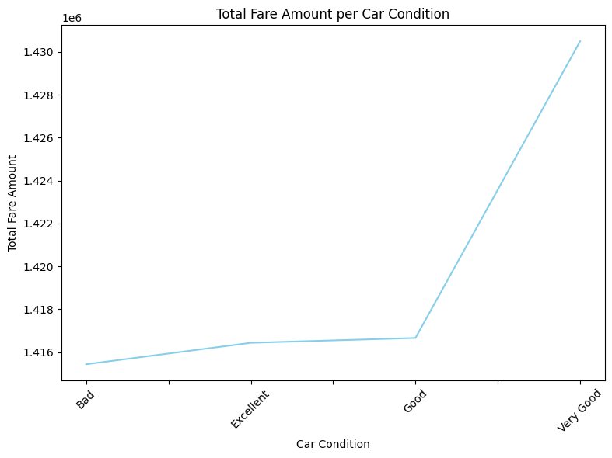
Car condition vs fare amount
This graph illustrates the total fare amount per car condition. As we can see, there is a slight variation in fare amounts across different car conditions. This data is crucial for understanding how the condition of a vehicle might impact pricing strategies and customer satisfaction. By analyzing these trends, we can make informed decisions to optimize our service offerings and ensure a consistent experience for our customers.

Slide 7
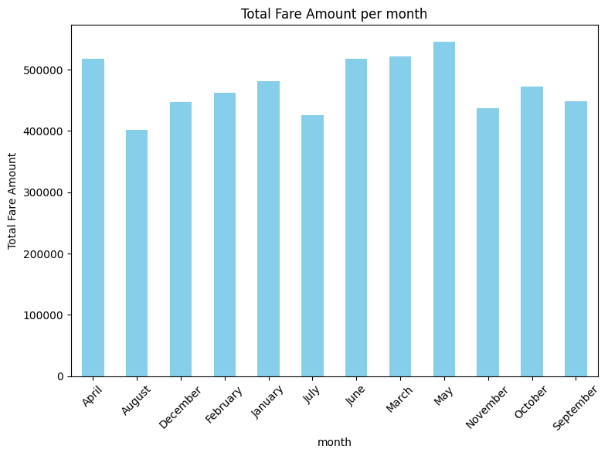
Seasonal changes vs fare amount
This graph shows the total fare amount per month, providing a clear view of how revenue fluctuates over time. Understanding these monthly trends is essential for identifying seasonal patterns, peak periods, and potential areas for improvement in our service delivery. By closely monitoring these variations, we can better allocate resources, plan marketing strategies, and enhance overall operational efficiency to meet customer demand effectively.

Slide 8
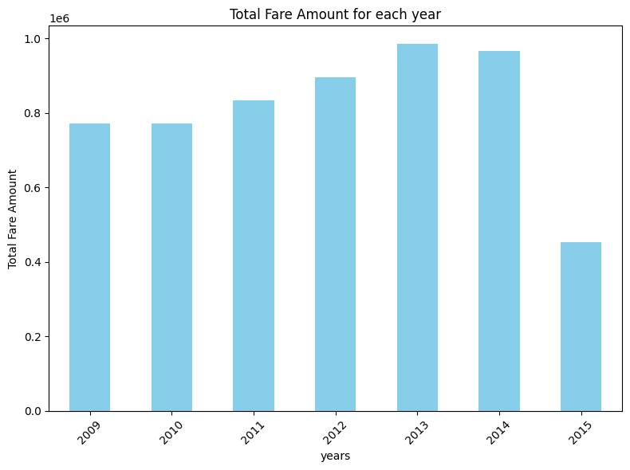
Yearly income
This graph displays the total fare amount for each year from 2019 to 2025. Observing the trends over these years allows us to assess the growth and performance of our services. Significant changes in fare amounts can indicate shifts in market demand, operational efficiency, or external factors affecting our business. By analyzing this data, we can identify long-term trends, set realistic goals, and develop strategies to sustain and enhance our growth trajectory.

Slide 9
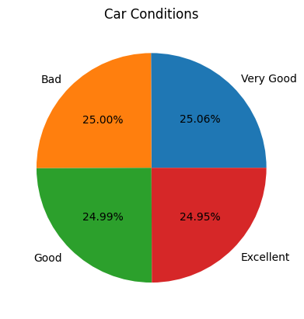
Car conditions distribution
This chart breaks down the distribution of car conditions, categorized as Very Good, Good, and Excellent. The percentages indicate the proportion of vehicles in each condition. Maintaining a high standard of car conditions is vital for ensuring customer satisfaction and safety. By monitoring these metrics, we can identify areas where maintenance or upgrades may be needed, ultimately enhancing the overall quality of our fleet and the experience we provide to our customers.

Slide 10
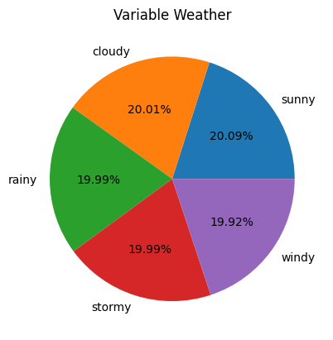
Weather distribution
This chart illustrates the distribution of variable weather conditions, such as cloudy, sunny, rainy, windy, and stormy. The percentages reflect the frequency of each weather type. Understanding these patterns is crucial for optimizing our operations, as weather conditions can significantly impact service demand and vehicle performance. By analyzing this data, we can better prepare for varying conditions, ensuring reliable service delivery and enhancing customer satisfaction regardless of the weather.

Slide 11
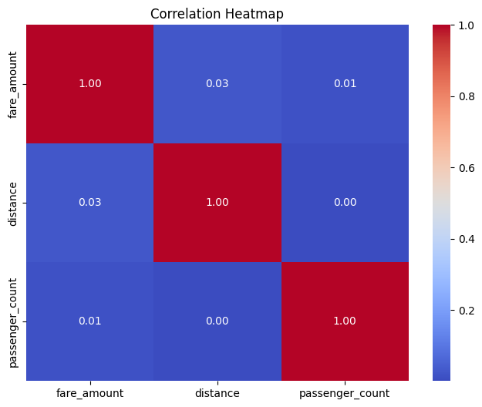
Important correlations
This correlation heatmap provides insights into the relationships between different variables such as fare amount, distance, and passenger count. The values indicate the strength and direction of these relationships, helping us understand how these factors interact. For instance, a high correlation between distance and fare amount suggests that longer trips generally result in higher fares. Analyzing these correlations allows us to refine our pricing models, optimize route planning, and enhance overall service efficiency to better meet customer needs.

Slide 12
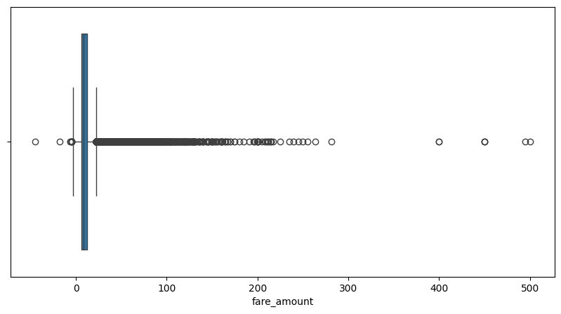
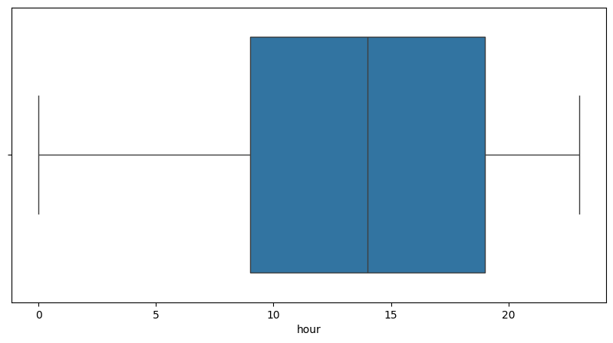
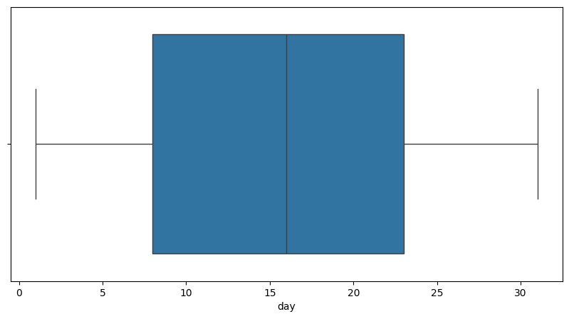
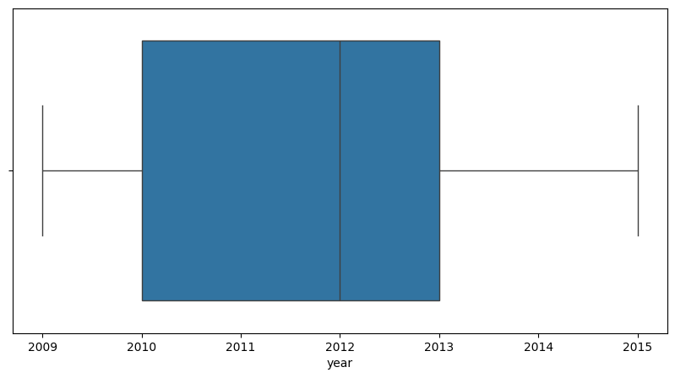
Possible outliers

